Slide 1
24
7
30
Topic: Perimeter
Date
EQ – How do we find the perimeter of different shapes?

Slide 2
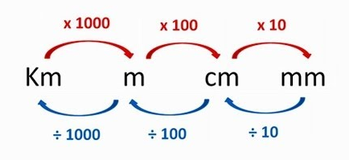
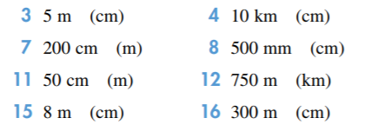
revision

Slide 3
revision
3) 500cm
4) 1 000 000cm
7) 2m
8) 50cm
11) 0.5m
12) 0.75km
15) 800 cm
16) 30 000cm

Slide 4
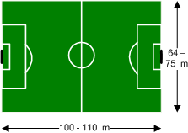
24
7
30
Topic: Perimeter
Date
EQ – How do we find the perimeter of different shapes?
Glossary Word
Perimeter
Perimeter
Is the distance along the boundary of a shape
Some examples:
A fence is built along the perimeter of a property
A soccer pitch has boundary lines along the perimeter

Slide 5
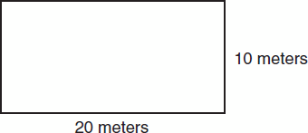
24
7
30
Topic: Perimeter
Date
EQ – How do we find the perimeter of different shapes?
Perimeter
To find the perimeter we add up the lengths of the sides.
P = 20 + 10 + 20 + 10
= 60 m

Slide 6
24
7
30
Topic: Perimeter
Date
EQ – How do we find the perimeter of different shapes?
Perimeter
Or we can use the formula P = (L + W) x 2
l = length
w = width
P = (L + W) x 2
= (20 + 10) x 2
= 60 m
Method
Rectangle
P = (L +W) x 2

Slide 7
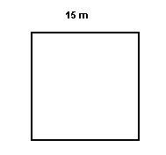
24
7
30
Topic: Perimeter
Date
EQ – How do we find the perimeter of different shapes?
Method
Rectangle
P = (L +W) x 2
Square
P = 4 x L
Perimeter
P = 15 + 15 + 15 + 15
= 60 m
OR
P = 4 x 15
= 60 m

Slide 8
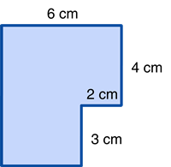
24
7
30
Topic: Perimeter
Date
EQ – How do we find the perimeter of different shapes?
Perimeter
P = 6 + 4 + 2 + 3 + 4 + 7
= 10 + 10 + 6
P = 26 cm
7 cm
4 cm

Slide 9
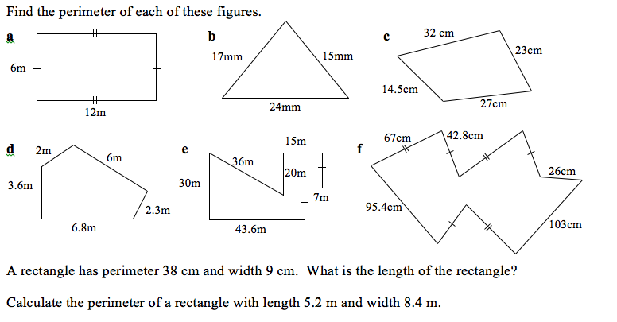
Task
1.
2.
3.

